Slide 1

Traditional Bangladeshi Food Classification using Transfer Learning and Convolutional Neural Network.
Nahiyan Bin Noor
Graduate Student, Department of System Engineering,
University of Arkansas at Little Rock

Slide 2
Problem Outline
7 classes of traditional food will be classified.
Using Transfer Learning Method
A Scratch Convolutional Neural Network Model

Slide 3
Dataset Description
The dataset is from a recent published paper
2619 Training data
216 data as validation

Slide 4
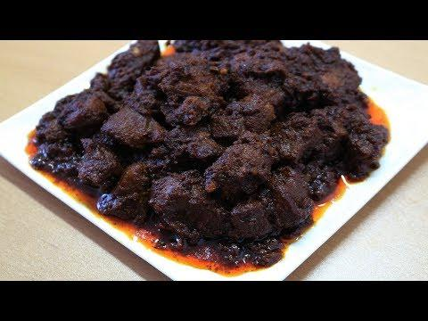
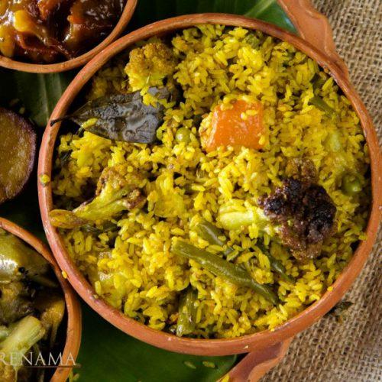
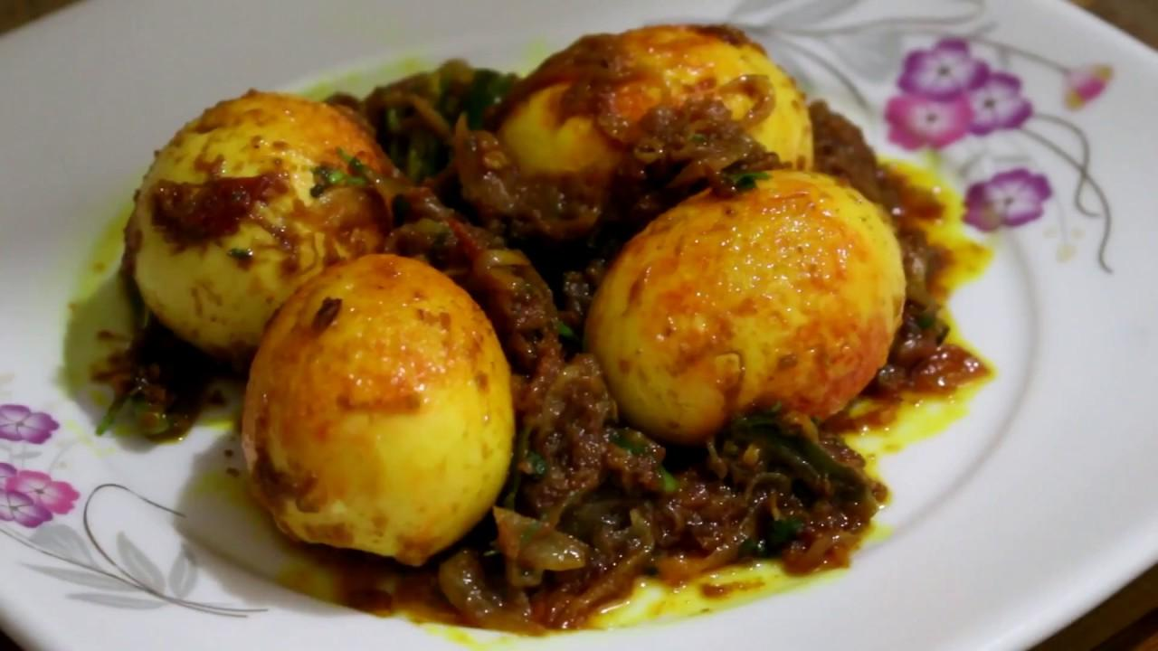
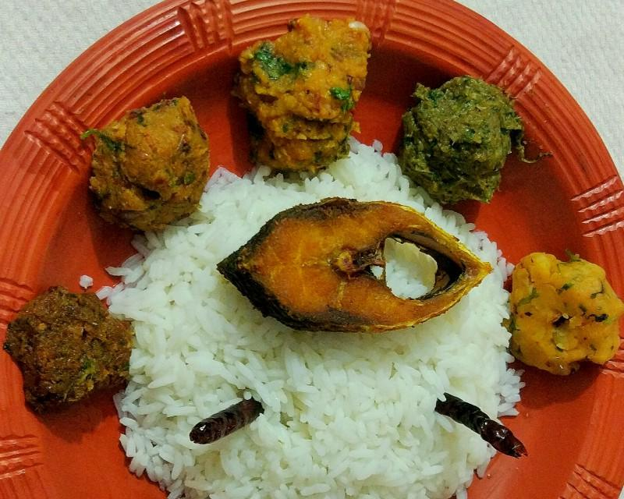
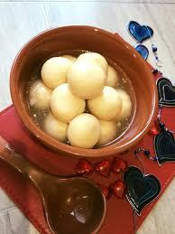
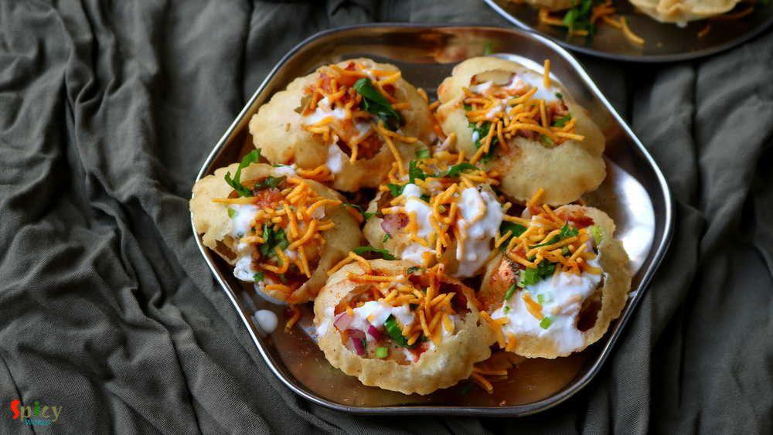
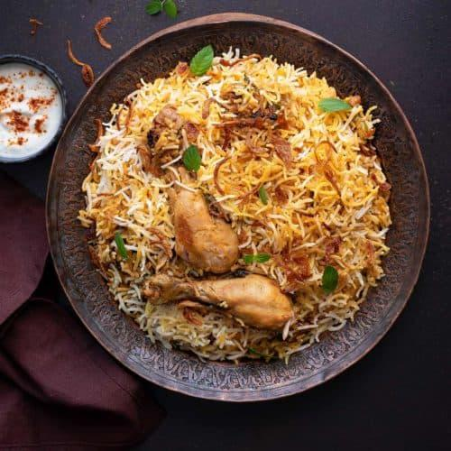
The images of 7 different Classes
Class 3
Class 4
Class 1
Class 2
Class 5
Class 6
Class 7

Slide 5
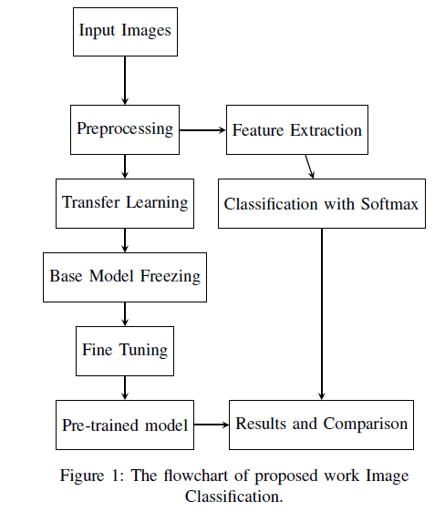
Methodology

Slide 6
Transfer Learning
Using a pre-trained model with different dataset by fine tuning.
ImageNet Dataset.

Slide 7
Some Popular Architectures
VGG16
VGG19
ResNet50
Xception
InceptionResNetV2

Slide 8
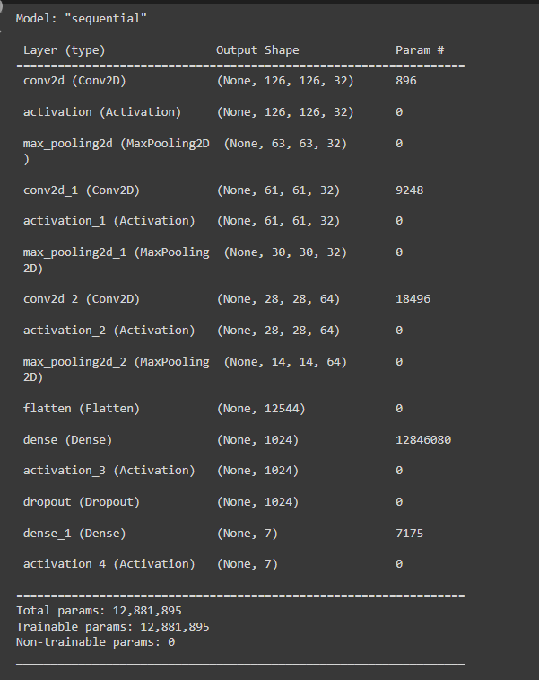
CNN Model

Slide 9
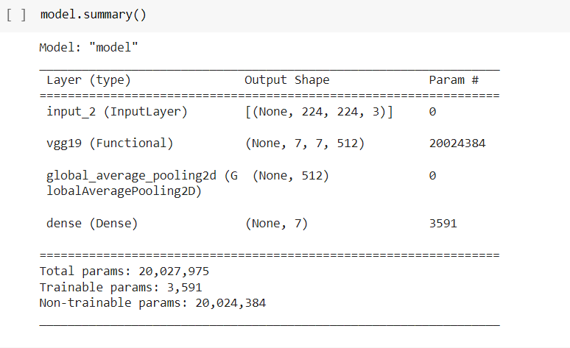
VGG19

Slide 10
Comparison Between transfer learning and CNN
CNN 78%
VGG16 92%
VGG19 94%
ResNet50 61%
Xception 65%
InceptionResNetV2 75%

Slide 11
Results of VGG19
 | Precision | Recall | F1_score | Number of images
Class_1 | 1.00 | 0.90 | 0.95 | 21
Class_2 | 0.88 | 1.00 | 0.93 | 43
Class_3 | 0.92 | 0.96 | 0.94 | 25
Class_4 | 0.85 | 0.94 | 0.89 | 18
Class_5 | 0.92 | 0.92 | 0.92 | 38
Class_6 | 1.00 | 0.83 | 0.91 | 35
Class_7 | 1.00 | 0.97 | 0.99 | 36
Average | 0.94 | 0.94 | 0.94 | 216
Accuracy | 0.94

Slide 12
Results of CNN (128x128)
 | Precision | Recall | F1_score | Number of images
Class_1 | 0.95 | 0.95 | 0.95 | 21
Class_2 | 0.78 | 0.93 | 0.85 | 43
Class_3 | 0.79 | 0.76 | 0.78 | 25
Class_4 | 0.59 | 0.56 | 0.57 | 18
Class_5 | 0.74 | 0.66 | 0.69 | 38
Class_6 | 0.62 | 0.60 | 0.61 | 35
Class_7 | 0.97 | 0.94 | 0.96 | 36
Average | 0.78 | 0.77 | 0.77 | 216
Accuracy | 0.78

Slide 13
Results
Results | Transfer Learning |  |  |  |  | CNN Scratch Model
 | VGG16 | VGG19 | ResNet50 | Xception | Inception ResNetV2 | 128x128 | 224x224
Accuracy | 92% | 94% | 61% | 65% | 75% | 78% | 73%
Recall | 90% | 93% | 61% | 65% | 68% | 77% | 71%
Precision | 94% | 94% | 64% | 70% | 76% | 78% | 74%
F1_Score | 92% | 93% | 60% | 64% | 71% | 77% | 71%

Slide 14
Conclusion
In this work we used total 2835 images to classify 7 classes of image.
We may get better accuracy if the dataset were bigger with the scratch CNN model.
We can change the CNN model to get better accuracy.

Slide 15
Thank You
Question ?

